Slide 1
NP-Completeness of the
Steiner Tree Problem
Simone Bianco - 1986936
Computational Complexity
Sapienza University of Rome

Slide 2
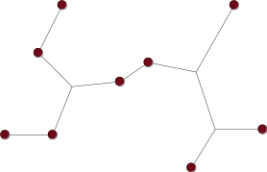
The Steiner Tree Problem
The Steiner Tree problem refers to a family of optimization problems, all seeking an optimal interconnection for a specified set of objects under a predefined objective function.
Frequent Objective Function: Minimize the lengths of the interconnections
NP-Completeness of the Steiner Tree Problem – Simone Bianco

Slide 3
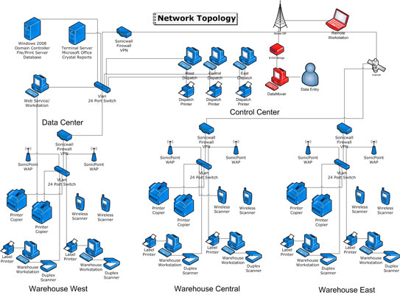

The Steiner Tree Problem
Commonly used for VLSI circuit designs, Network design and Biochemistry.
NP-Completeness of the Steiner Tree Problem – Simone Bianco

Slide 4
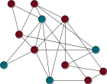
The Steiner Tree Problem
Given a subset of nodes S ⊆ V(G), a sub-tree T of G is a Steiner Tree for S if S ⊆ V(T)
NP-Completeness of the Steiner Tree Problem – Simone Bianco

Slide 5
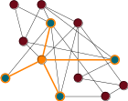
The Steiner Tree Problem
Given a subset of nodes S ⊆ V(G), a sub-tree T of G is a Steiner Tree for S if S ⊆ V(T)
NP-Completeness of the Steiner Tree Problem – Simone Bianco

Slide 6
The Steiner Tree Problem
Optimization problem: Given a graph G and subset of nodes S ⊆ V(G), find a Steiner Tree for S (if any) with the minimum number of edges.
Decision problem: Given a graph G, a subset of nodes S ⊆ V(G) and a value k, is there a Steiner Tree for S with at most k edges?
NP-Completeness of the Steiner Tree Problem – Simone Bianco

Slide 7
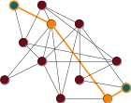
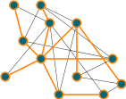
ST as generalization of other problems
When │S│ = 2 the ST problem becomes the Shortest Path Problem
When │S│ = n the ST problem becomes the Minimum Spanning Tree problem
NP-Completeness of the Steiner Tree Problem – Simone Bianco

Slide 8
ST is in NP
Given ⟨G,S,k⟩ ∈ ST, the witness is the Steiner Tree T itself:
Check that T is a sub-graph of G
Check that T is acyclic
Check that S ⊆ V(T)
Check that │E(T)│≤ k
NP-Completeness of the Steiner Tree Problem – Simone Bianco

Slide 9
Idea behind the NP-Hardness of ST
Idea: We can use Steiner Trees to “force” some kind of cover
The Set Cover (SC) problem is usually a suitable candidate for this idea
⟹ The decision version is NP-Complete — hardness by reduction from Vertex Cover (VC)
NP-Completeness of the Steiner Tree Problem – Simone Bianco

Slide 10
Set Cover
U = {x1, x2, x3, x4, x5, x6, x7}
C1 = {x1, x2, x4, x7} C2 = {x1, x3, x5, x6 } C3 = {x3, x5, x7}
Conditions:
The sub-collection must cover U
The sub-collection must have minimal cardinality
NP-Completeness of the Steiner Tree Problem – Simone Bianco

Slide 11
Set Cover
Optimization problem: Given a set U = {x1, …, x3q} and a collection of subsets 𝒞 = {C1, …, Cm}, find the minimal cardinality sub-collection 𝒞* ⊆ 𝒞 that covers U.
Decision problem: Given a set U = {x1, …, x3q}, a collection of subsets 𝒞 = {C1, …, Cm} and an integer k > 0, is there a sub-collection 𝒞* ⊆ 𝒞 that covers U and such that │𝒞*│≤ k?
NP-Completeness of the Steiner Tree Problem – Simone Bianco

Slide 12
Attempt reduction from SC to ST
Constructing the graph G:
For every sub-set Cj we add a node uj
For every element xj ∈ U we add a node vj — if xj ∈ Ci then we add the edge (ui , vj)
We add a special node z and the edge (z, ui) for all i ∈ [m]
Set of terminal nodes: S = {z, x1, …, x3q}
NP-Completeness of the Steiner Tree Problem – Simone Bianco

Slide 13
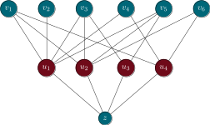
Attempt reduction from SC to ST
Example:
U = {x1, x2, x3, x4, x5, x6}
C1 = {x1, x2, x3, x4, x5}
C2 = {x1, x3, x5, x6}
C3 = {x3, x5}
C4 = {x1, x4, x6}
NP-Completeness of the Steiner Tree Problem – Simone Bianco

Slide 14
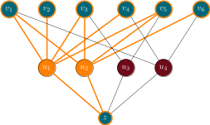
Attempt reduction from SC to ST
Example:
U = {x1, x2, x3, x4, x5, x6}
C1 = {x1, x2, x3, x4, x5}
C2 = {x1, x3, x5, x6}
C3 = {x3, x5}
C4 = {x1, x4, x6}
NP-Completeness of the Steiner Tree Problem – Simone Bianco

Slide 15
Attempt reduction from SC to ST
Example:
U = {x1, x2, x3, x4, x5, x6}
C1 = {x1, x2, x3, x4, x5}
C2 = {x1, x3, x5, x6}
C3 = {x3, x5}
C4 = {x1, x4, x6}
Not a Tree!
NP-Completeness of the Steiner Tree Problem – Simone Bianco

Slide 16
Exact Cover
Idea: Use a variant of the Set Cover problem ⟹ Exact Cover (XC)
XC is NP-Complete — hardness by reduction from 3-Coloring (3COL)
NP-Completeness of the Steiner Tree Problem – Simone Bianco

Slide 17
Exact Cover
Idea: Use a variant of the Set Cover problem ⟹ Exact Cover (XC)
XC is NP-Complete — hardness by reduction from 3-Coloring (3COL)
Conditions of XC:
The sub-collection must cover U be a partition of U ⟹ No more cycles!
The sub-collection must have minimal cardinality
NP-Completeness of the Steiner Tree Problem – Simone Bianco

Slide 18
Attempt reduction from XC to ST
Does the reduction still fail? Yes: the number of edges of the output tree is too variable
NP-Completeness of the Steiner Tree Problem – Simone Bianco

Slide 19
Attempt reduction from XC to ST
Does the reduction still fail? Yes: the number of edges of the output tree is too variable
Examples:
If │U│= n, 𝒞 = {{x1, …, xn-1}, {xn}} and k = n then T will have n+2 edges
If │U│= n, 𝒞 = {{x1}, …, {xn}} and k = n then T will have 2n edges
⟹ We cannot find a “good” common value k’ for the output triple ⟨G,S,k’⟩
NP-Completeness of the Steiner Tree Problem – Simone Bianco

Slide 20
Exact Cover by 3-Sets
Idea: Use a variant of the Exact Cover problem ⟹ Exact Cover by 3-Sets (X3C)
X3C is NP-Complete — hardness by reduction from 3-Dimensional Matching (3DM)
NP-Completeness of the Steiner Tree Problem – Simone Bianco

Slide 21
Exact Cover by 3-Sets
Idea: Use a variant of the Exact Cover problem ⟹ Exact Cover by 3-Sets (X3C)
X3C is NP-Complete — hardness by reduction from 3-Dimensional Matching (3DM)
Conditions of X3C:
The sub-collection must be a partition of U ⟹ No more cycles!
The sub-collection must have minimal cardinality
U has 3q elements and each Ci has 3 elements
NP-Completeness of the Steiner Tree Problem – Simone Bianco

Slide 22
Exact Cover by 3-Sets
Obs. If │U│= 3q and 𝒞* is an X3C then │𝒞*│= q
⟹ All X3Cs have the same cardinality, hence we can drop the minimality constraint
Decision problem: Given a set U = {x1, …, x3q} and a collection of subsets 𝒞 = {C1, …, Cm} such that │Ci│= 3, is there a sub-collection 𝒞* ⊆ 𝒞 that is a partition of U?
NP-Completeness of the Steiner Tree Problem – Simone Bianco

Slide 23
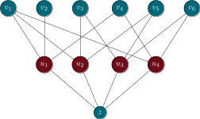
Reduction from X3C to ST
Example:
U = {x1, x2, x3, x4, x5, x6}
C1 = {x1, x2, x4}
C2 = {x1, x3, x5}
C3 = {x3, x5, x6}
C4 = {x1, x4, x6}
NP-Completeness of the Steiner Tree Problem – Simone Bianco

Slide 24
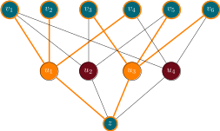
Reduction from X3C to ST
Example:
U = {x1, x2, x3, x4, x5, x6}
C1 = {x1, x2, x4}
C2 = {x1, x3, x5}
C3 = {x3, x5, x6}
C4 = {x1, x4, x6}
NP-Completeness of the Steiner Tree Problem – Simone Bianco

Slide 25
Reduction from X3C to ST
Claim: U has an Exact Cover by 3-Sets over 𝒞 iff G has a Steiner Tree for S with 4q edges
NP-Completeness of the Steiner Tree Problem – Simone Bianco

Slide 26
Reduction from X3C to ST
Claim: U has an Exact Cover by 3-Sets over 𝒞 iff G has a Steiner Tree for S with 4q edges
⟹)
If 𝒞* ⊆ 𝒞 is an X3C of U then │𝒞*│= q ⟶ W.l.o.g. assume 𝒞* = {C1, …, Cq}
T is made of the edges that have u1, …, uq as endpoints ⟶ T has 4q edges
𝒞* is an exact cover ⟶ T covers S and it is acyclic
NP-Completeness of the Steiner Tree Problem – Simone Bianco

Slide 27
Reduction from X3C to ST
Claim: U has an Exact Cover by 3-Sets over 𝒞 iff G has a Steiner Tree for S with 4q edges
⟸)
If T is an ST for S with at 4q edges ⟶ T must contain u1, …, ut
If t > q then S has more than 4q edges ⟶ Contradiction
If t < q then S cannot cover all terminals ⟶ Contradiction
𝒞* ={C1, …, Cq} is an Exact 3-Cover of U
NP-Completeness of the Steiner Tree Problem – Simone Bianco

Slide 28
References
M. R. Garey and D. S. Johnson. “The Rectilinear Steiner Tree Problem Is NP-Complete.” SIAM Journal on Applied Mathematics 32, no. 4 (1977).
http://www.jstor.org/stable/2100192
M. W. Bern and R. L. Graham “The Shortest-Network Problem” in Scientific American Magazine Vol. 260 No. 1 (1989). doi:10.1038/scientificamerican0189-84
NP-Completeness of the Steiner Tree Problem – Simone Bianco

Slide 29
Thank you for the attention!

